Slide 1
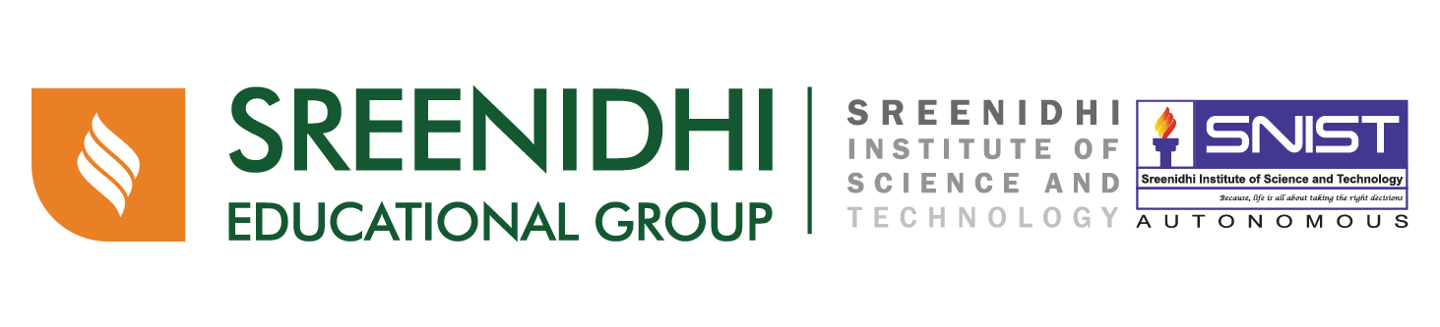
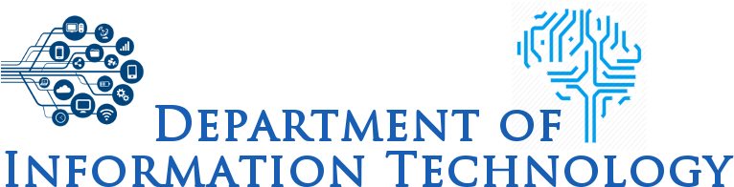
Brain Stroke Prediction using
ML and Data Science
Batch No. 20 :
17311A1289 – Anil .M 17311A12A7 – Abhinay .L 17311A12A8 – Venkatesh .V
Guide – Ms. Sree Vidya

Slide 2
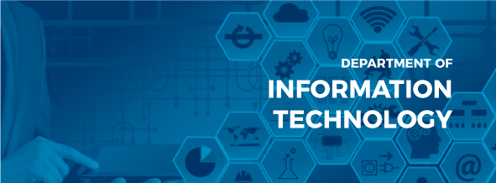
Introduction:
Machine Learning (ML) delivers an accurate and quick prediction outcome and it has become a powerful tool in health settings, offering personalized clinical care for stroke patients.
Our Project Aims to build the better model In terms of all the evaluation metrics and we hope it might help in the field of Healthcare, so that the death rates related to it might reduce.

Slide 3
Objective:
The Main Objective of our Project is to Extract the Patterns and Insights from the Data collected form the Various Sources and Use It to Detect/Predict Whether a Person is Suffering From Brain Stroke or Not.
Apart from this Prediction we can also find some Useful information in the EDA Stage, where we can find information like, whether the Males/Females are more likely to be suffering from this Disease, What is the min Age groups of the people suffering from this disease and many more.

Slide 4
Software Information:
1. The Software's which we are using to build this project are,
1. Jupyter Notebook
2. Google Colab
3. Python
So, The main aim of using these software are because they help us to analyze and extract the information from the dataset more efficiently rather than using traditional consoles.
Jupyter Notebook : The Jupyter Notebook is an open-source web application that allows you to create and share documents that contain live code, equations, visualizations and narrative text. Uses include: data cleaning and transformation, numerical simulation, statistical modeling, data visualization, machine learning, and much more.
Google Collab : Google Collab Notebooks execute our code on google cloud servers meaning we can leverage the power of google hardware, Including GPU'S AND TPU'S Regardless of the power of our machines.
Google collab is built on top of Jupyter Notebook and it also comes with Python Programming Language,

Slide 5
Applications:
The main Application of our project is, using the data collected from the sources and transforming it, we build a model verifying all its evaluation metrics and with the help of it, we try to predict whether a person is suffering from Brain Stroke or not.
So, As we all know NON contrast CT scan is the current standard for initial screening of the head trauma and Brain Related Diseases, so we aimed to develop a model which might reduce the usage of CT scan Because CT scan delivers high dose of radiation to the patient which is very harmful for them in the near future.

Slide 6
Thank You
Any Queries ?

